Slide 1
Sales Analytics
File created on: 8/25/2023 6:03:22 AM

Slide 2
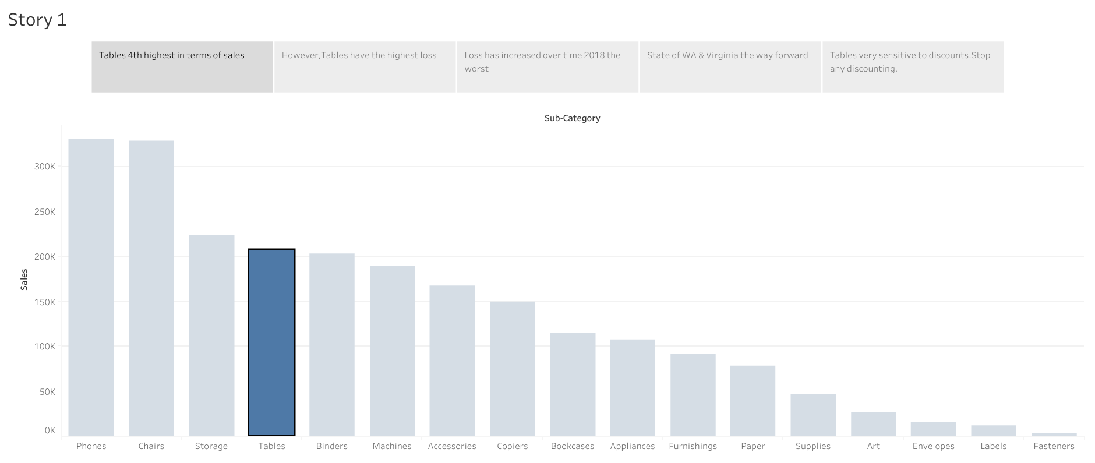

Slide 3
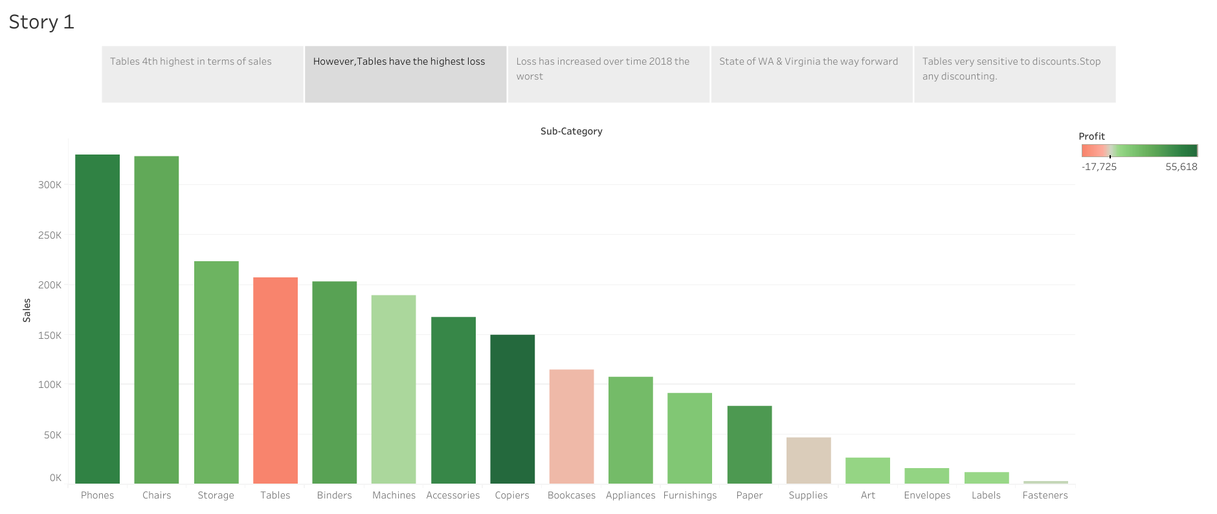

Slide 4
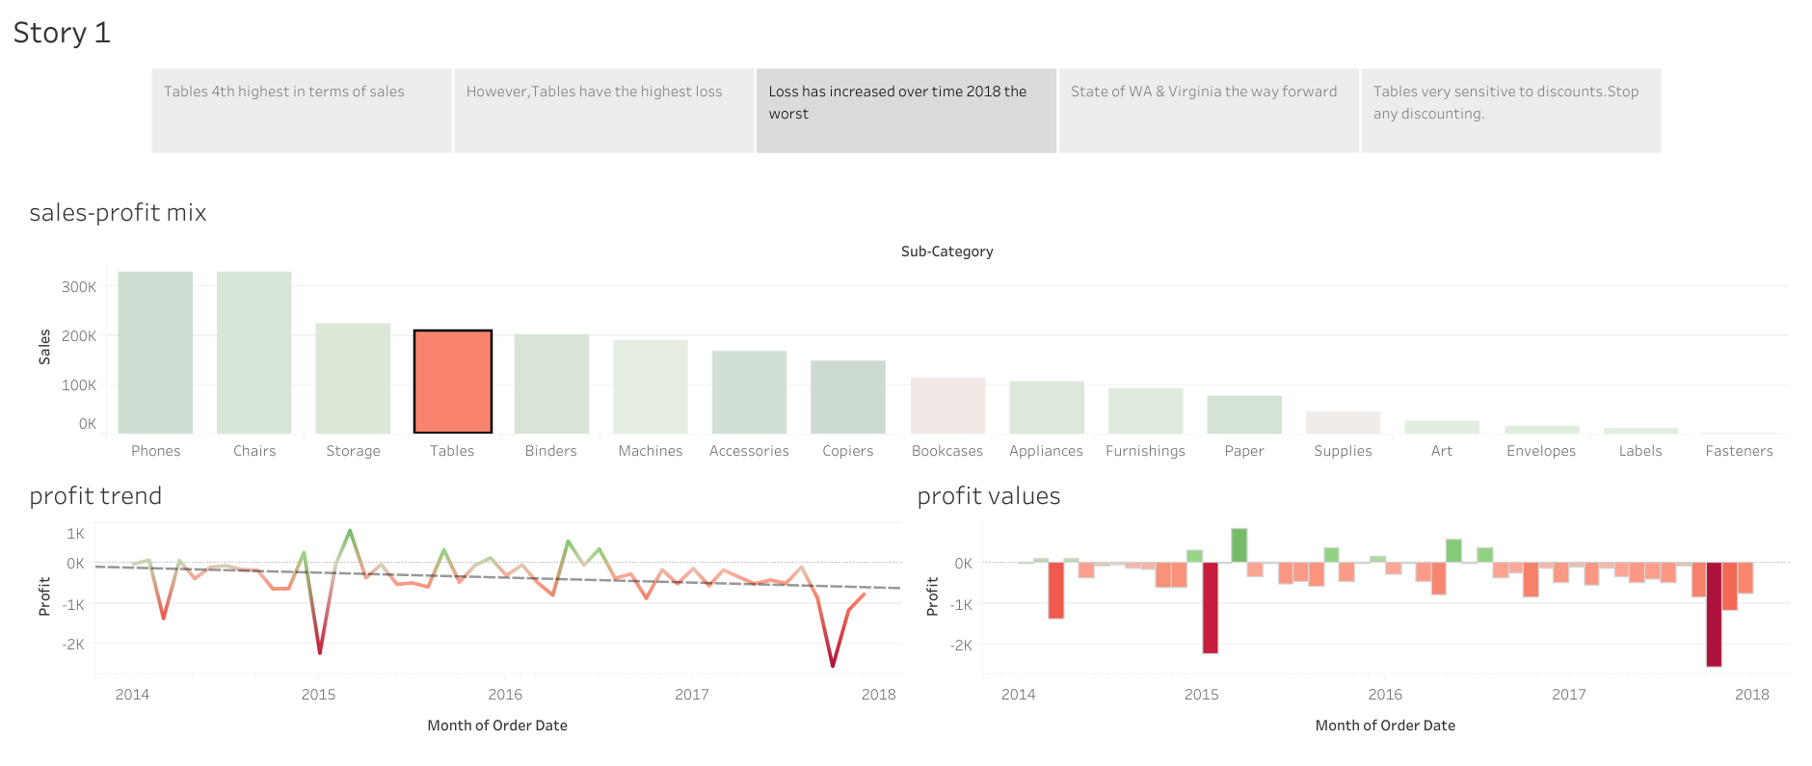

Slide 5
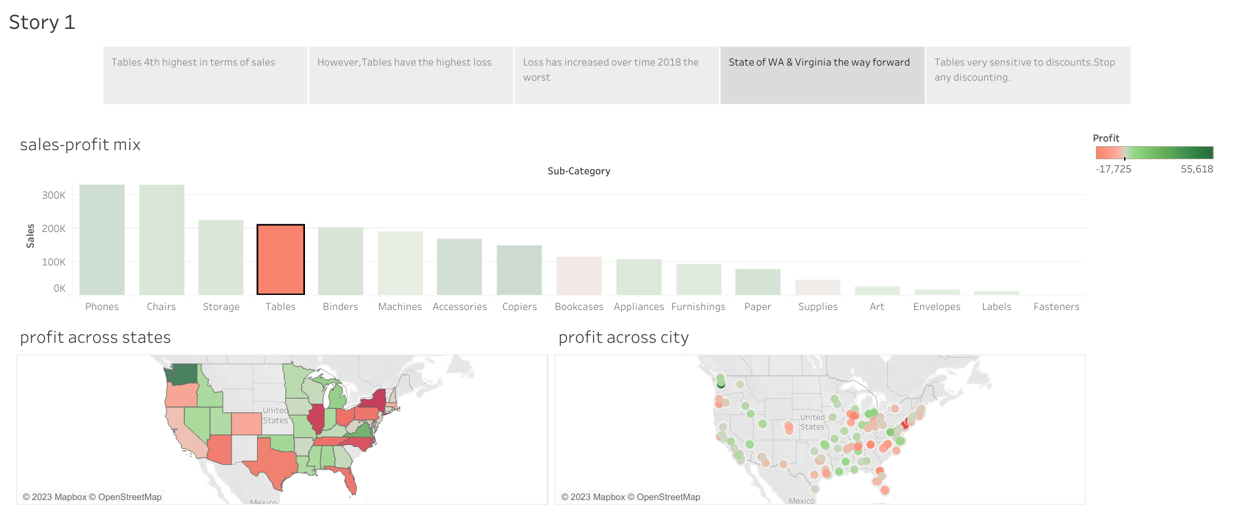

Slide 6
